Slide 1

SonarQube
Code Quality Tool | SAST Tool
Presented By :
Amrit Choudhary

Slide 2



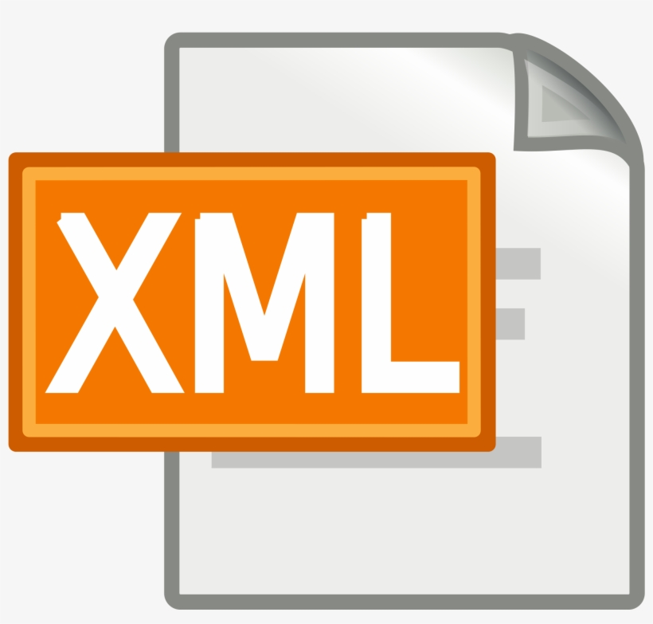
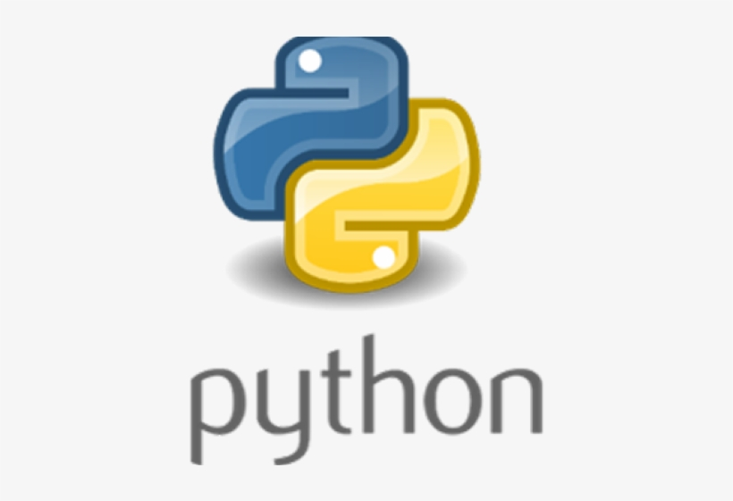
SonarQube
SonarQube
It is an open source tool developed by SonarSource for continuous inspection of code quality, perform automatic detection of static analysis of code to detect bugs, code smells, and security vulnerabilities on 25+ programming languages.
SonarQube offers reports on duplicated code, coding standards, unit tests, code coverage, code complexity, comments, bugs, and security vulnerabilities.

Slide 3
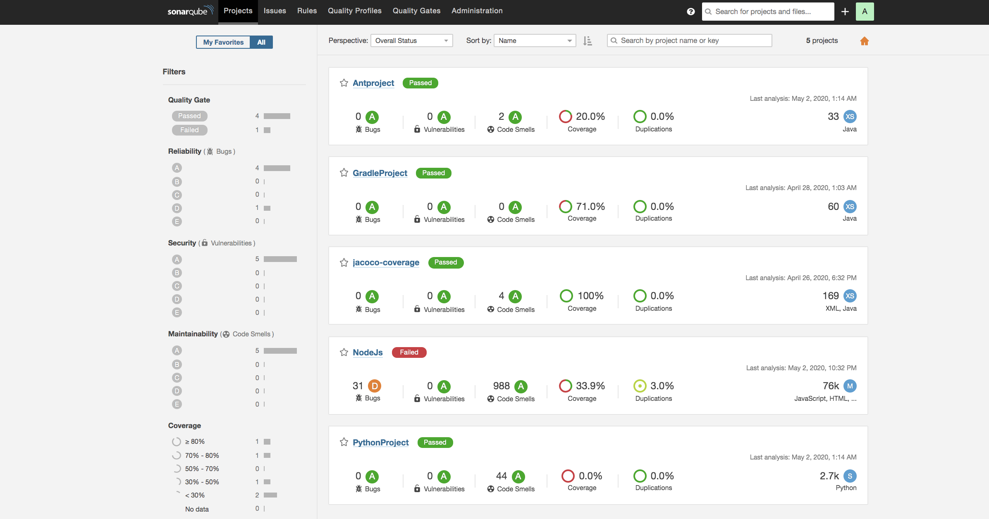
Sonar Dashboard

Slide 4
Technical Terms/Filters
Quality Gate : Default or custom
Reliability / Bugs : Error or Bugs in the code
Security / Vulnerabilities :Security bugs or vulnerabilities detection
Maintainability / Code Smells : Bad smell in code
Coverage : coverage of the unit / integration test cases
Duplications : duplicate lines of code/ function/ block/ files
Size: lines / classes / comments /files on code.
Languages: programming languages
Complexity : difficult to understand

Slide 5


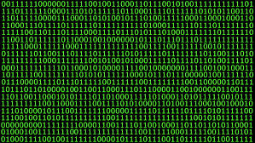
Quality Gate:
Code complexity:
Code Smell :
Security / Vulnerability :

Slide 6



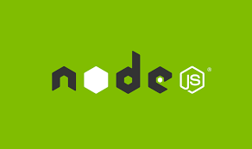
Projects
1) Ant Project
2) Maven Project
3) Gradle Project
4) NodeJS Project
5) Python Project

